Slide 1
HORIZONTAL PLAYBOOK
LCS ULTIMATE 2026

Slide 2
OFFENSE

Slide 3
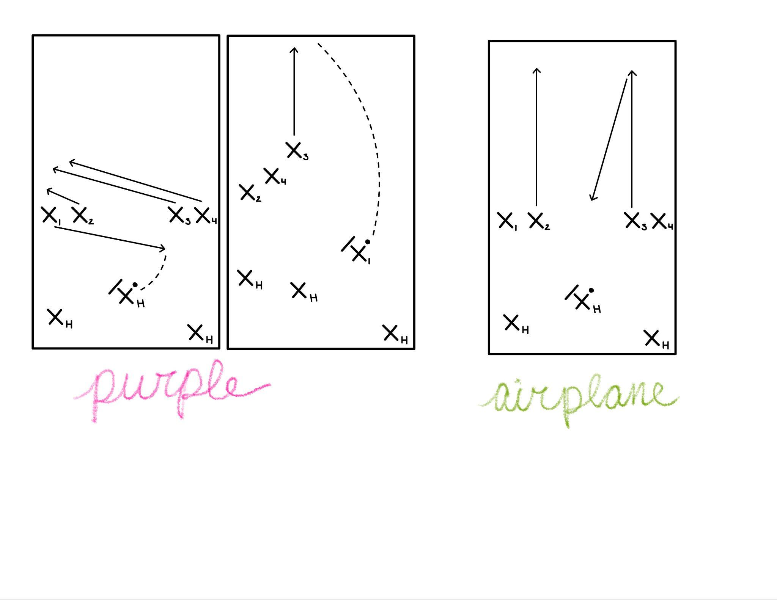
Purple
Cutters 2, 3, 4 cut deep and clear to the break side to make space for cutter 1
1 slashes across the field to the open side
3 times their cut so that when 1 is catching the disc, they are striking deep
Cutter 4 needs to cut past 3 to prevent a pick on the initial cut
Can be run from 1 or 4; if 4 slashes under, 2 continues
This is an initiation play! Flow into vertical after the play is run

Slide 4
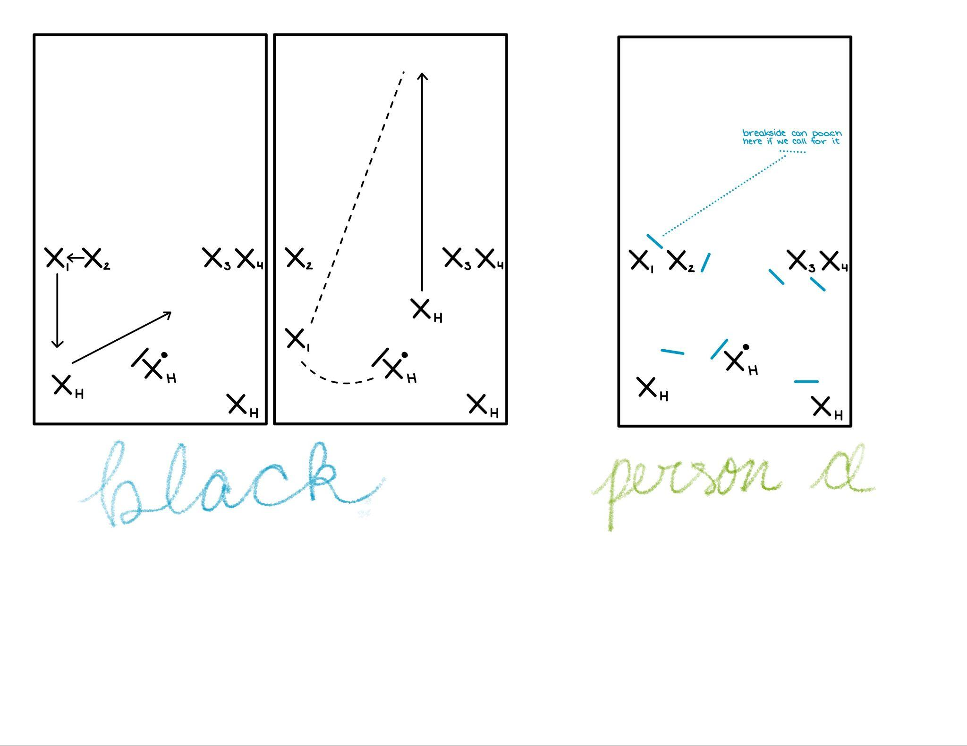
Black
Breakside handler cuts a burkley infront of middle hander, then strikes deep from the middle
As soon as handler cuts, cutter 1 cuts into the position to receive the disc
Cutter 2 push to sideline
Look to continue disc to the handler striking

Slide 5
Airplane
Cutter 2 and 3 cut out hard, and initiator comes under
Continuation should cut next if initiator gets the disc - look for deep continuation first, come under if not open

Slide 6
DEFENSE

Slide 7
Horizontal Person-Defense
Handlers (3) - play tight defense taking away easy resets
Mark - hold the force, don’t allow break throws, communicate “up” when disc is thrown and “break” if your mark is broken
Open-side handler - play tight defense, staying between your person and the disc
Break-side handler - can poach into the lane for stalls 1-3, prevent up-field throws
Cutters - on the open side, stay within an arm’s distance, on the open-side of the player
On the break side, you can poach off into the deep space slightly - don’t get burnt if the player goes under

